Slide 1

UKACM-SEMNI Autum School
Lecture 3: Multiscale modeling and Recurrent Neural Operator
Dr Burigede Liu
University of Cambridge
Email: BL377@cam.ac.uk

Slide 2
Overview of today’s lecture
Basics of multi-scale modeling
Two scale expansion and micro to macro transition
Example – 1D viscoelasticity
Recurrent neural operator

Slide 3
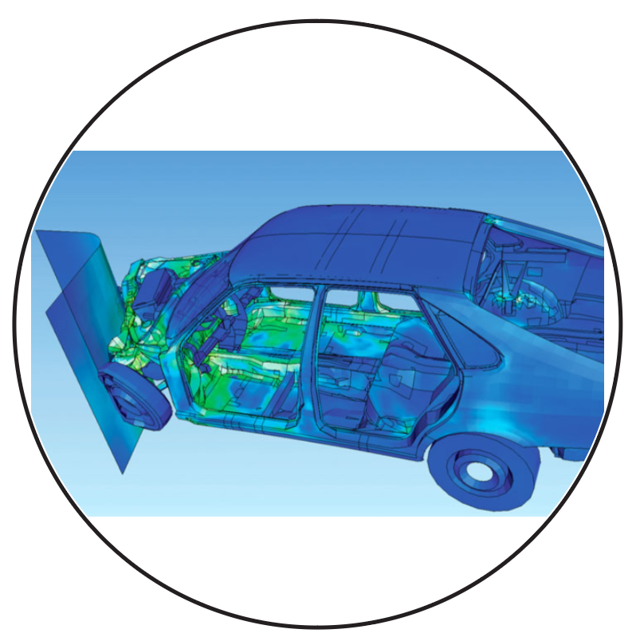
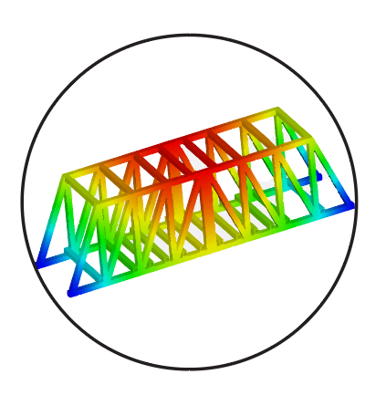
General Framework for Mechanical Design
1
Application

Slide 4
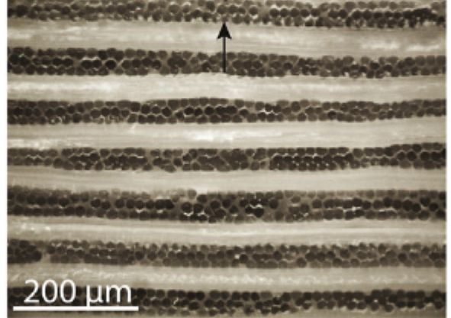
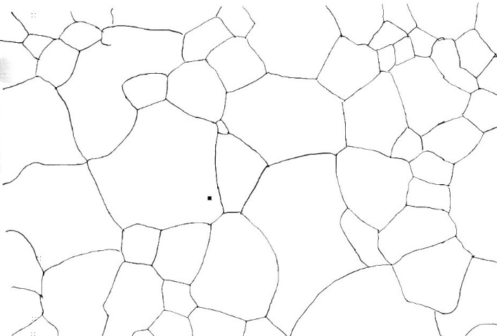
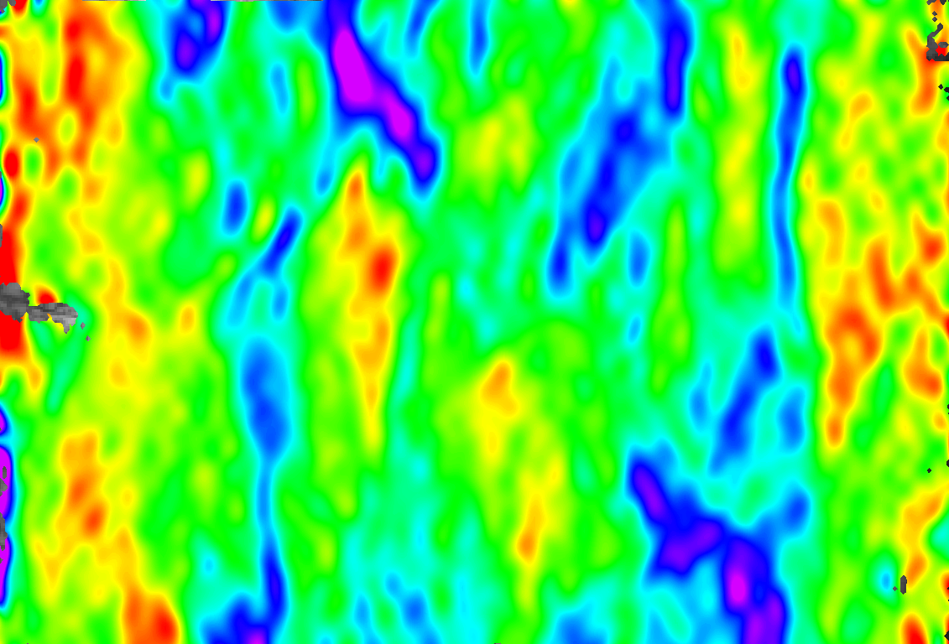
General Framework for Mechanical Design
Composites?
1
Application
Metals?
2
Material system

Slide 5
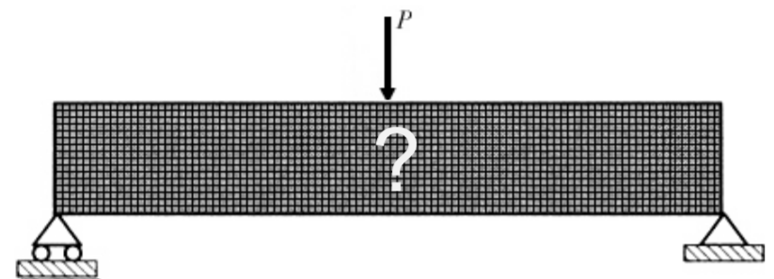
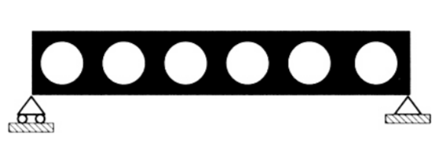
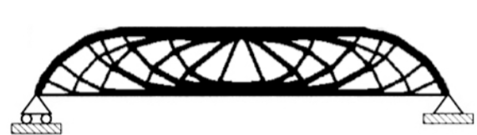
General Framework for Mechanical Design
3
Structure
1
Application
2
Material system

Slide 6
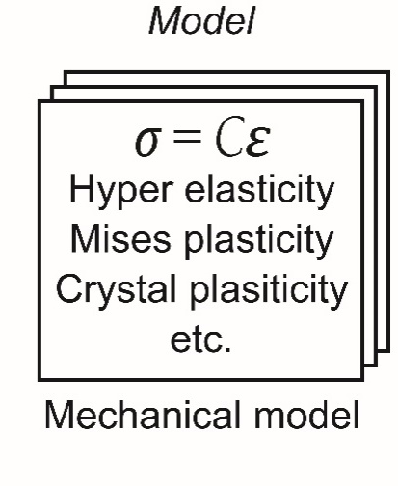
General Framework for Mechanical Design
3
Structural
Design
Simulate, design,
Optimize
4
Constitutive
Model
1
Application
2
Material system

Slide 7
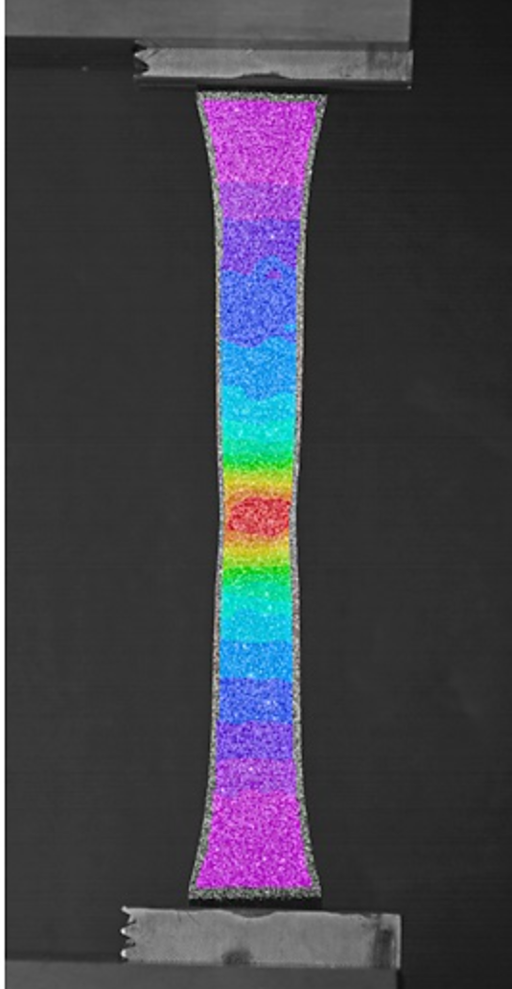
General Framework for Mechanical Design
3
Structural
Design
Experiments
Simulate, design,
Optimize
Parameters
Assumption
4
Constitutive
Model
1
Application
DIC
2
Material system

Slide 8
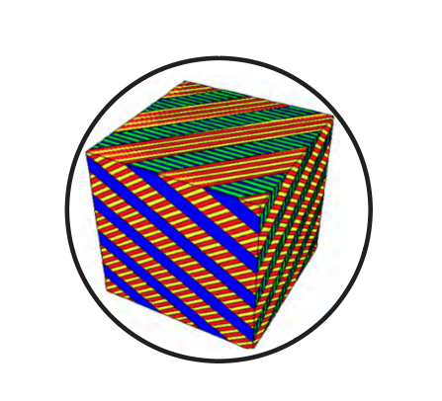
General Framework for Mechanical Design
3
Structural
Design
Experiments
Simulate, design,
Optimize
Parameters
Assumption
4
Constitutive
Model
1
Application
5
Lower
scale
model
Guess
Crystal plasticity
Asymptotic
2
Material system

Slide 9
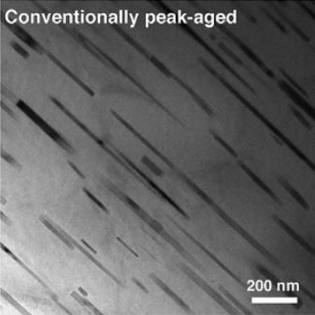
General Framework for Mechanical Design
3
Structural
Design
Experiments
Simulate, design,
Optimize
Parameters
Experiments
Assumption
4
Constitutive
Model
1
Application
5
Lower
scale
model
Guess
Crystal plasticity
Asymptotic
2
Material system

Slide 10
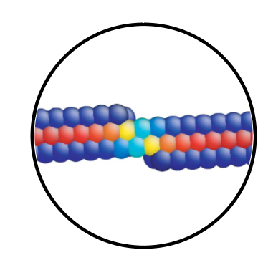
General Framework for Mechanical Design
3
Structural
Design
Experiments
Simulate, design,
Optimize
Parameters
Experiments
Assumption
MD
4
Constitutive
Model
1
Application
5
Lower
scale
model
Guess
Asymptotic
2
Material system
6
Lower
scale
model

Slide 11
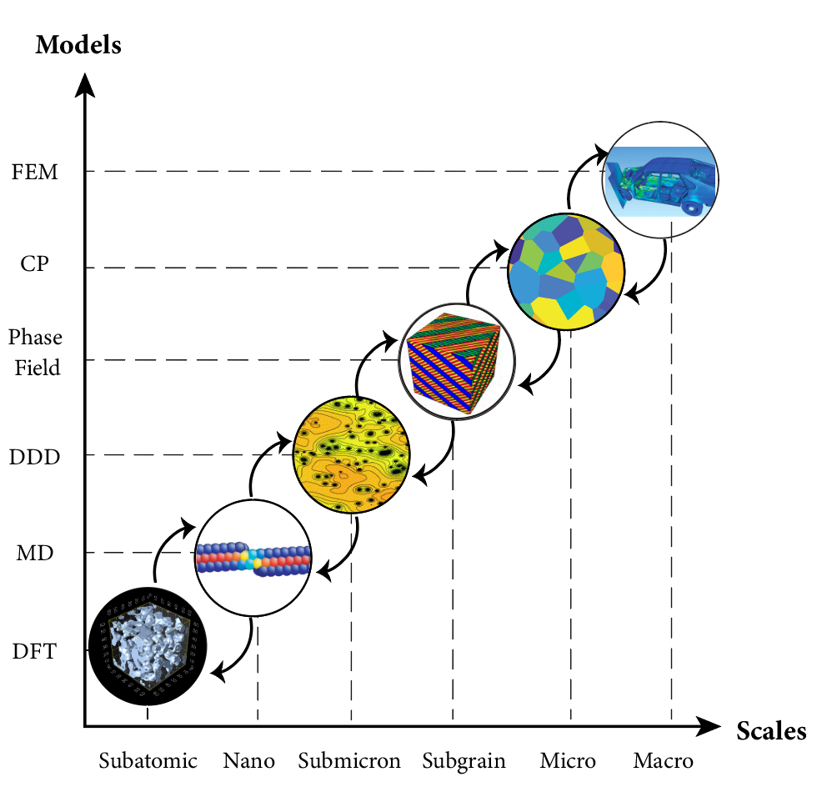
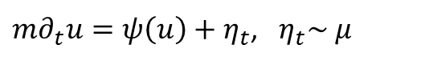

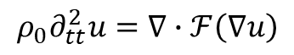
Lower length scale physics are unified by PDEs
Wave
$$ρ_{0}∂_{tt}^{2}u=∇∙ℱ\left(∇u\right)$$
Filtering (Averaging)
Diffusion
$$∂_{t}u=∇∙\left(D\left(u\right)∇φ(u)\right)$$
Modulate (Boundary Condition)
SDE
$m∂_{t}u=ψ\left(u\right)+η_{t}$, $η_{t}\sim μ$

Slide 12
Multiscale modeling
A dimension reduction process – what information should we pass?
4
Constitutive
Model
5
Lower
scale
model
Guess
Asymptotic

Slide 13
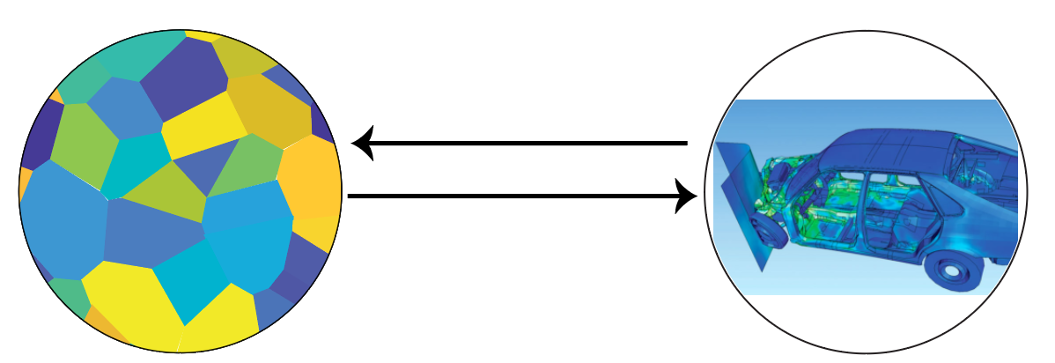

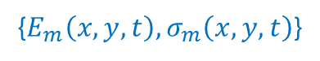
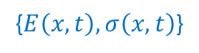
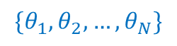
Multiscale modeling approaches
Two scale problem
Two scale problem in stress analysis
When speaking multiscale problems:
We often refer to a simple scenario of a two-scale problem.
Macroscale: larger scale (e.g., engineering device level).
Microscale: small scale (e.g., atomc scale)
We are interested in the macroscopic response of a body and how it depends on features on the microscale of the consisting materials.
Ultimately, we would like to tackle the inverse problem: to achieve certain macroscale behavior, how do we design the microscale response?
{$E_{m}\left(x,y,t\right),σ_{m}\left(x,y,t\right)$}
{$E\left(x,t\right),σ\left(x,t\right)$}
$$\{θ_{1},θ_{2},…,θ_{N}\}$$
Microscale
Macroscale
($Y$periodic)
Notes:
The macroscopic behavior of materials are complex and the end result of many mechanisms operating across a broad range of disparate length scales. Multiscale modeling is fundamentally a ‘divide-and-conquer’ paradigm whereby the entire range of material behavior is divided into a hierarchy of length scales. The mechanisms at Coarser length scales will both filter (means averaging) the finer length scale mechanisms and also modulate (set boundary condition for) the finer scale mechanisms. Therefore it forms a functional hierarchy so that at any time we would only need to understand the two adjacent scale problem.

Slide 14
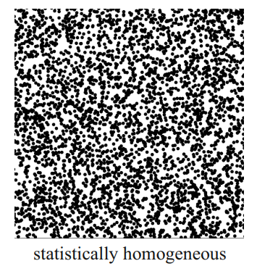
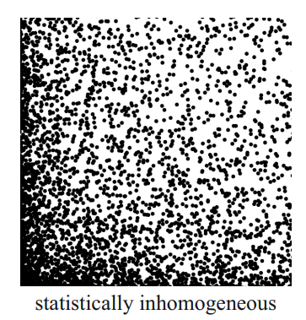
Multiscale modeling approaches
Key assumption
A key assumption of most multi-scale model is that a material is statistically homogeneous.
Statistical properties include:
Volume averages
Two-point correlation
N-point correlation
Higher order statistics.
A key consequence is that we may assume that the macroscale properties of a material are independent of where on the macroscale we probe the material response.
Notes:
The macroscopic behavior of materials are complex and the end result of many mechanisms operating across a broad range of disparate length scales. Multiscale modeling is fundamentally a ‘divide-and-conquer’ paradigm whereby the entire range of material behavior is divided into a hierarchy of length scales. The mechanisms at Coarser length scales will both filter (means averaging) the finer length scale mechanisms and also modulate (set boundary condition for) the finer scale mechanisms. Therefore it forms a functional hierarchy so that at any time we would only need to understand the two adjacent scale problem.

Slide 15
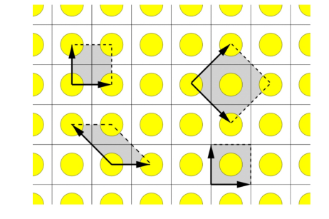
Multiscale modeling
Microstructure
Often display either randomness or periodicity.
Periodic microstructures:
Admits the identification of a unit cell as the simplest (smallest) repeating substructure
Example: Atoms/lattices.
Periodic microstructure
Translation invariance
Notes:
The macroscopic behavior of materials are complex and the end result of many mechanisms operating across a broad range of disparate length scales. Multiscale modeling is fundamentally a ‘divide-and-conquer’ paradigm whereby the entire range of material behavior is divided into a hierarchy of length scales. The mechanisms at Coarser length scales will both filter (means averaging) the finer length scale mechanisms and also modulate (set boundary condition for) the finer scale mechanisms. Therefore it forms a functional hierarchy so that at any time we would only need to understand the two adjacent scale problem.

Slide 16
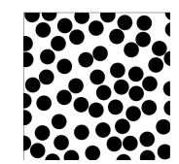
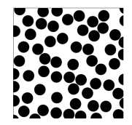
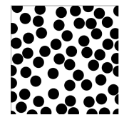
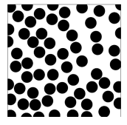
Multiscale modeling
Microstructure
Often display either randomness or periodicity.
Periodic microstructures:
Admits the identification of a unit cell as the simplest (smallest) repeating substructure
Example: Atoms/lattices.
Random microstructures:
Each realization is different.
Four different realizations of a fiber composite in a unit cell
Notes:
The macroscopic behavior of materials are complex and the end result of many mechanisms operating across a broad range of disparate length scales. Multiscale modeling is fundamentally a ‘divide-and-conquer’ paradigm whereby the entire range of material behavior is divided into a hierarchy of length scales. The mechanisms at Coarser length scales will both filter (means averaging) the finer length scale mechanisms and also modulate (set boundary condition for) the finer scale mechanisms. Therefore it forms a functional hierarchy so that at any time we would only need to understand the two adjacent scale problem.

Slide 17
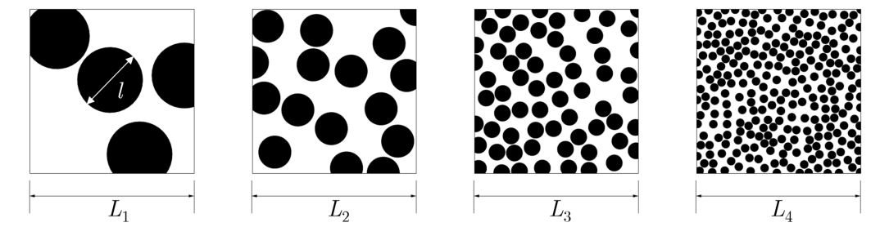
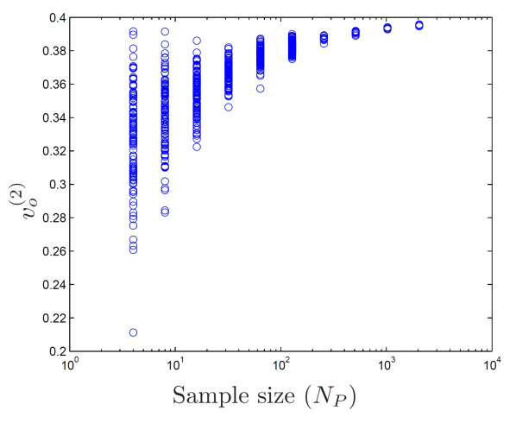
Multiscale modeling
Microstructure
Often display either randomness or periodicity.
Periodic microstructures:
Admits the identification of a unit cell as the simplest (smallest) repeating substructure
Example: Atoms/lattices.
Random microstructures:
Each realization is different.
Can reach a statistical limit by sample enlargement.
Can define a statistically representative unit cell.
Unit cell is oftentimes called a Representative Volume Element (RVE).
Increasing the unit cell size
Notes:
The macroscopic behavior of materials are complex and the end result of many mechanisms operating across a broad range of disparate length scales. Multiscale modeling is fundamentally a ‘divide-and-conquer’ paradigm whereby the entire range of material behavior is divided into a hierarchy of length scales. The mechanisms at Coarser length scales will both filter (means averaging) the finer length scale mechanisms and also modulate (set boundary condition for) the finer scale mechanisms. Therefore it forms a functional hierarchy so that at any time we would only need to understand the two adjacent scale problem.

Slide 18
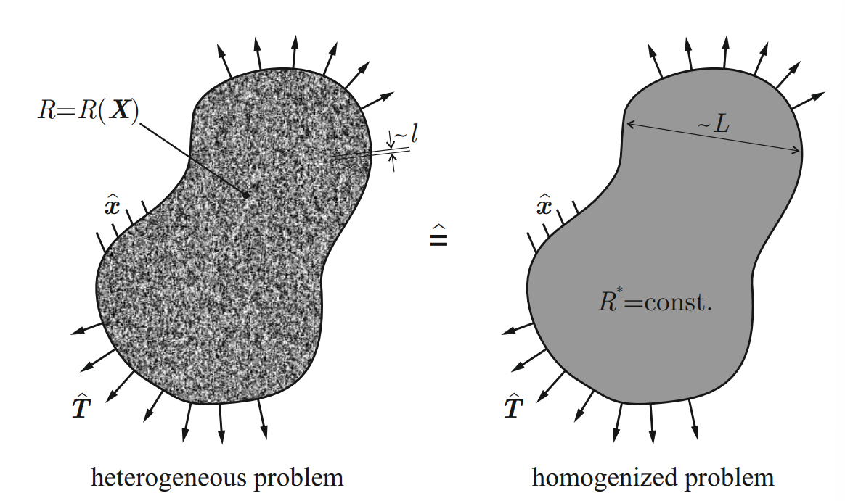
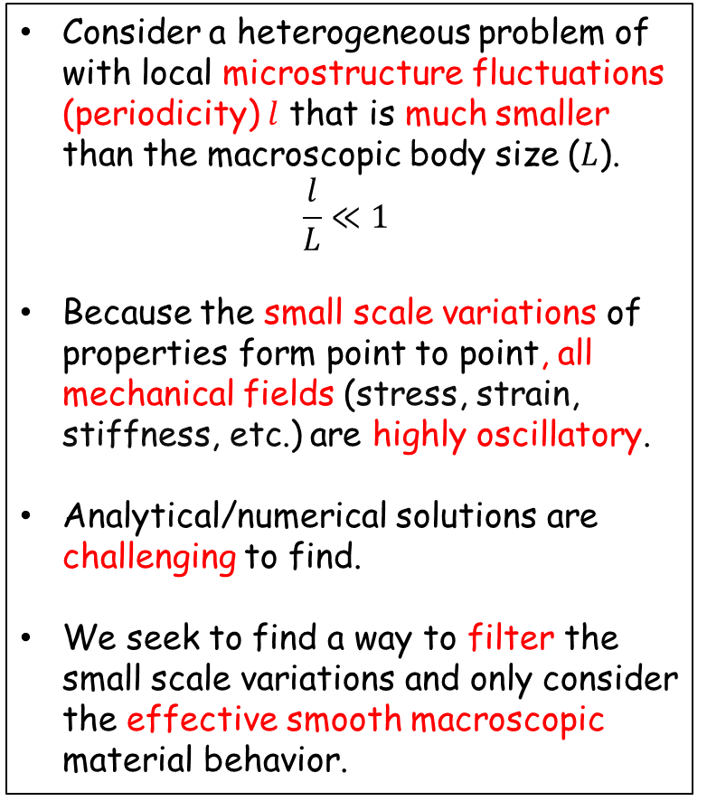
Multi-scale modeling
Consider a heterogeneous problem of with local microstructure fluctuations (periodicity) $l$ that is much smaller than the macroscopic body size ($L$).
$$\frac{l}{L}≪1$$
Because the small scale variations of properties form point to point, all mechanical fields (stress, strain, stiffness, etc.) are highly oscillatory.
Analytical/numerical solutions are challenging to find.
We seek to find a way to filter the small scale variations and only consider the effective smooth macroscopic material behavior.
Notes:
The macroscopic behavior of materials are complex and the end result of many mechanisms operating across a broad range of disparate length scales. Multiscale modeling is fundamentally a ‘divide-and-conquer’ paradigm whereby the entire range of material behavior is divided into a hierarchy of length scales. The mechanisms at Coarser length scales will both filter (means averaging) the finer length scale mechanisms and also modulate (set boundary condition for) the finer scale mechanisms. Therefore it forms a functional hierarchy so that at any time we would only need to understand the two adjacent scale problem.

Slide 19
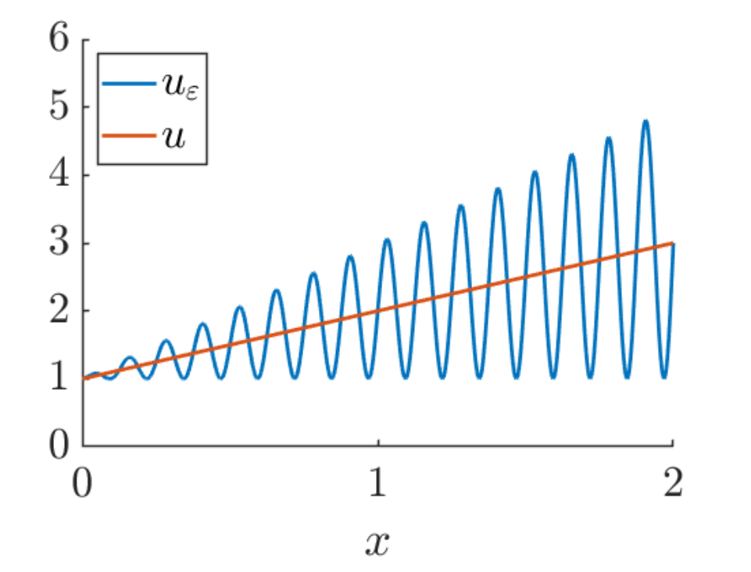
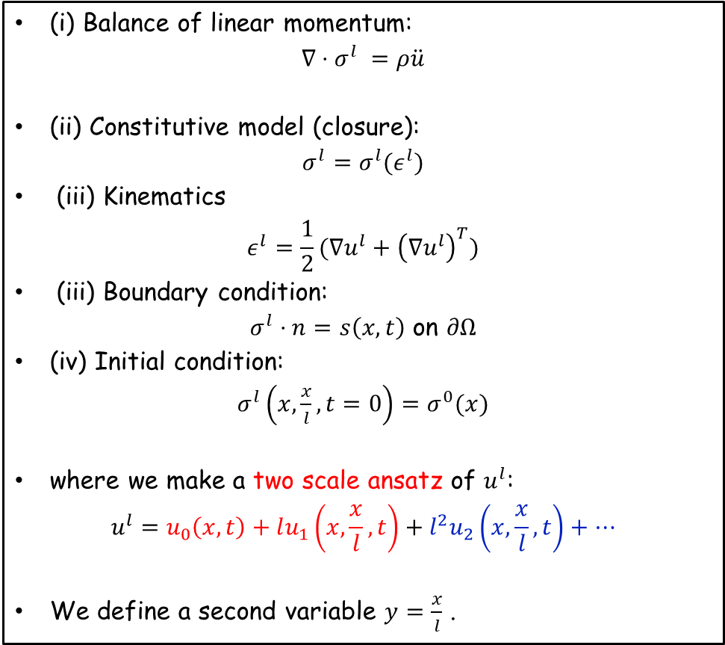

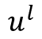
Mathematical theory of homogenization
Example – solid mechanics
(i) Balance of linear momentum:
$$∇⋅σ^{l} =ρ\ddot{u}$$
(ii) Constitutive model (closure):
$$σ^{l}=σ^{l}(ε^{l})$$
(iii) Kinematics
$$ε^{l}=\frac{1}{2}(∇u^{l}+{\left(∇u^{l}\right)}^{T})$$
(iii) Boundary condition:
$σ^{l}⋅n=s\left(x,t\right)$ on $∂Ω$
(iv) Initial condition:
$σ^{l}\left(x,\frac{x}{l}, t=0\right)=σ^{0}(x)$
where we make a two scale ansatz of $u^{l}$:
$$u^{l}=u_{0}\left(x,t\right)+lu_{1}\left(x,\frac{x}{l},t\right)+l^{2}u_{2}\left(x,\frac{x}{l},t\right)+…$$
We define a second variable $y=\frac{x}{l}$ .
$$u^{l}$$
$$l$$
Notes:
The macroscopic behavior of materials are complex and the end result of many mechanisms operating across a broad range of disparate length scales. Multiscale modeling is fundamentally a ‘divide-and-conquer’ paradigm whereby the entire range of material behavior is divided into a hierarchy of length scales. The mechanisms at Coarser length scales will both filter (means averaging) the finer length scale mechanisms and also modulate (set boundary condition for) the finer scale mechanisms. Therefore it forms a functional hierarchy so that at any time we would only need to understand the two adjacent scale problem.

Slide 20
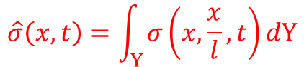


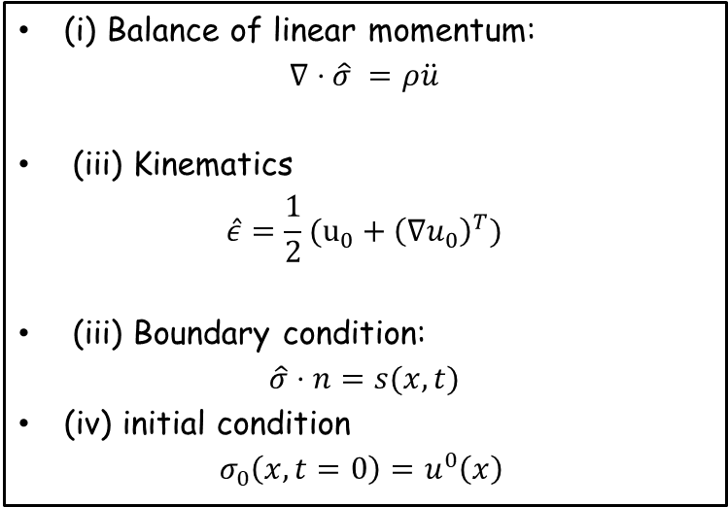


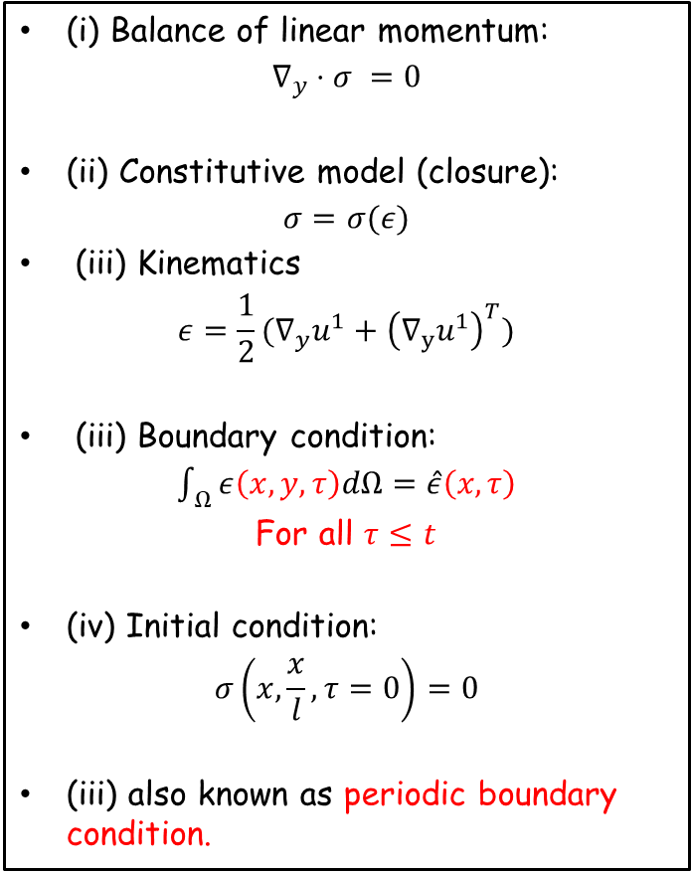
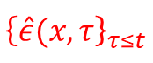
Micro-maro transition problem
Microscopic problem on an RVE of size $Y$
Macroscopic problem on $Ω$
(i) Balance of linear momentum:
$$∇_{y}⋅σ =0$$
(ii) Constitutive model (closure):
$$σ=σ(ε)$$
(iii) Kinematics
$$ε=\frac{1}{2}(∇_{y}u^{1}+{\left(∇_{y}u^{1}\right)}^{T})$$
(iii) Boundary condition:
$\int_{ Ω}{ε\left(x,y,τ\right)dΩ=\hat{ε}\left(x,τ\right)}$
For all $τ≤t$
(iv) Initial condition:
$$σ\left(x,\frac{x}{l},τ=0\right)=0$$
(iii) also known as periodic boundary condition.
(i) Balance of linear momentum:
$$∇⋅\hat{σ} =ρ\ddot{u}$$
(iii) Kinematics
$$\hat{ε}=\frac{1}{2}(u_{0}+{\left(∇u_{0}\right)}^{T})$$
(iii) Boundary condition:
$$\hat{σ}⋅n=s(x,t)$$
(iv) initial condition
$$σ_{0}\left(x,t=0\right)=u^{0}\left(x\right)$$
$$\hat{σ}\left(x,t\right)=\int_{Y}{σ\left(x,\frac{x}{l},t\right)dY}$$
$${\left\{\hat{ε}(x,τ\right\}}_{τ≤t}$$
$l$ independent!
Constitutive model (closure)
$${\left\{\hat{ε}(x,τ\right\}}_{τ≤t}↦\hat{σ}\left(x,t\right)$$
Notes:
The macroscopic behavior of materials are complex and the end result of many mechanisms operating across a broad range of disparate length scales. Multiscale modeling is fundamentally a ‘divide-and-conquer’ paradigm whereby the entire range of material behavior is divided into a hierarchy of length scales. The mechanisms at Coarser length scales will both filter (means averaging) the finer length scale mechanisms and also modulate (set boundary condition for) the finer scale mechanisms. Therefore it forms a functional hierarchy so that at any time we would only need to understand the two adjacent scale problem.

Slide 21
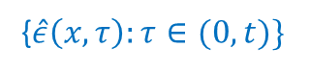



Classical approach – $FE^{2}$
Microscopic problem on an RVE of size $Y$
Compute the effective stress-strain relationship by parallelly solving the microscopic RVE problem and the Macroscopic IBVP problem.
Solve the unit cell initial-boundary value problem at each time, at each macroscopic quadrature point.
Do not requires a priori postulate.
E.g., no need to specify the material is isotropic/anisotropic, elastic/plastic etc., on macroscale.
We can incorporate lower length scale physics.
Prohibitively expensive with history.
Two scale problem
{$\hat{ε}\left(x,τ\right):τ∈(0,t)\}$
$$\hat{σ}\left(x,t\right)$$
Microscale
Macroscale
( periodic)
Notes:
The macroscopic behavior of materials are complex and the end result of many mechanisms operating across a broad range of disparate length scales. Multiscale modeling is fundamentally a ‘divide-and-conquer’ paradigm whereby the entire range of material behavior is divided into a hierarchy of length scales. The mechanisms at Coarser length scales will both filter (means averaging) the finer length scale mechanisms and also modulate (set boundary condition for) the finer scale mechanisms. Therefore it forms a functional hierarchy so that at any time we would only need to understand the two adjacent scale problem.

Slide 22
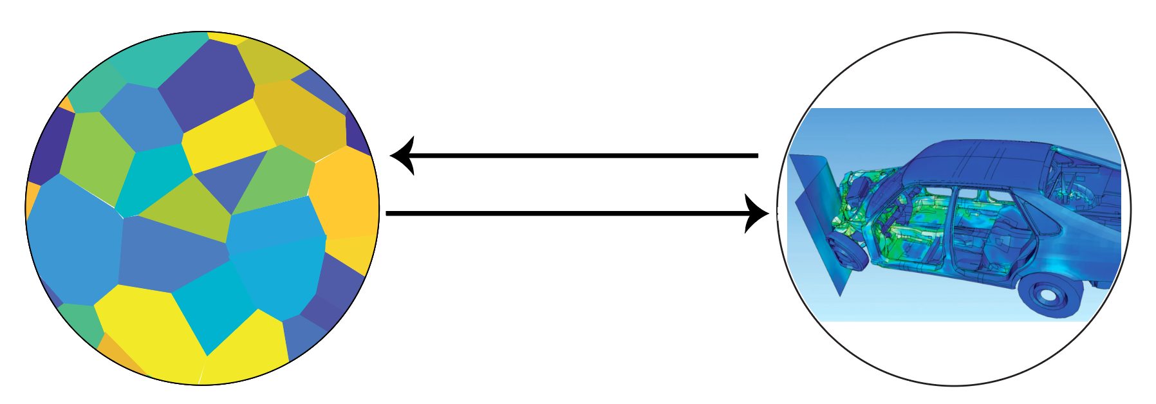
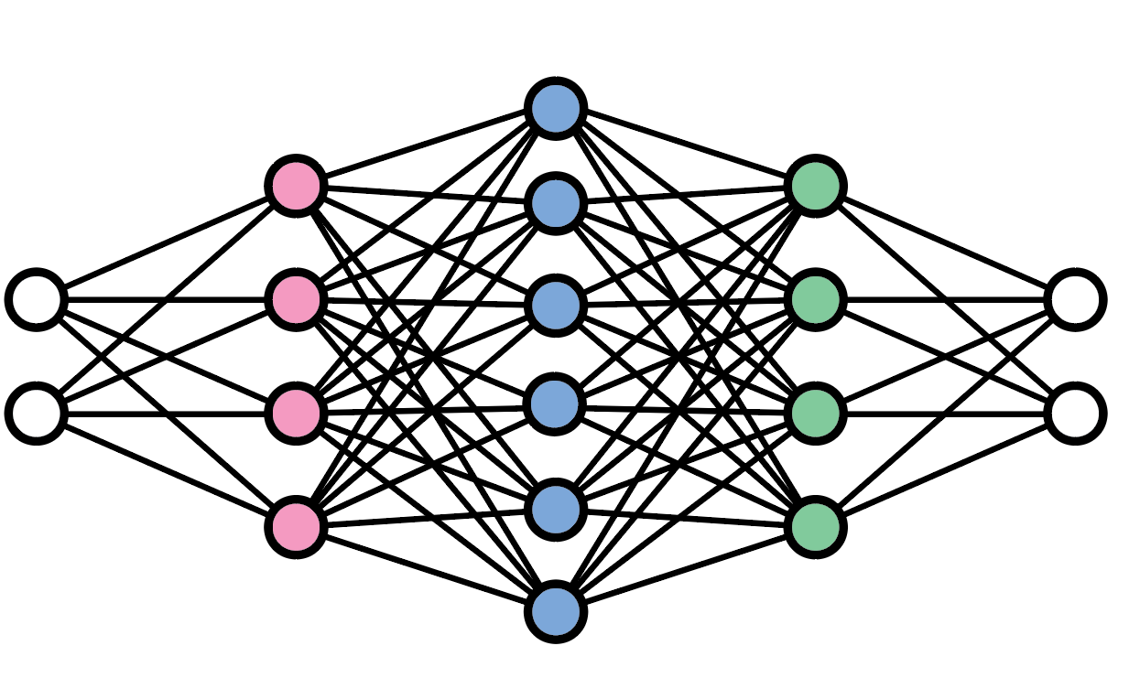
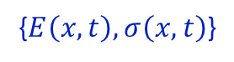

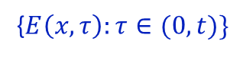
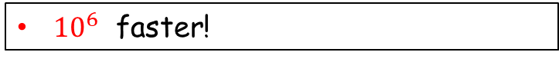

Learning based multiscale modeling
Learning based multiscale modeling
Neural operators as a surrogate model for the RVE IBVP problem.
Macroscale problem solved using Finite Element scheme.
Two scale problem in stress analysis
{$E_{m}\left(x,y,t\right),σ_{m}\left(x,y,t\right)$}
{$E\left(x,t\right),σ\left(x,t\right)$}
{$E\left(x,τ\right):τ∈(0,t)\}$
$$σ\left(x,t\right)={\left\langle σ_{m}(E+∇v,ξ, x, y)\right\rangle }_{Y}$$
Efficient specially for nonlinear problem
Microscale
Macroscale
${10}^{6}$ faster!
Neural operators as the macroscopic constitutive model!

Slide 23

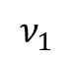
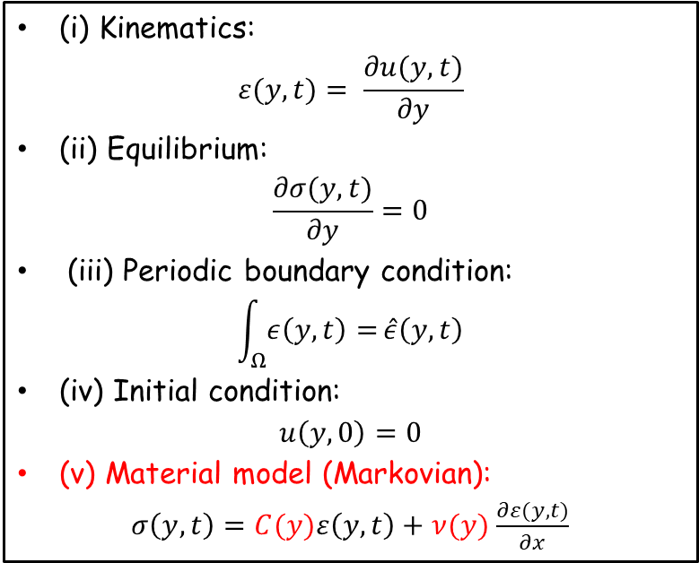
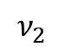









Example – 1D viscoelasticity
$$C_{1}$$
$$C_{2}$$
$$…$$
$$C_{2}$$
$$C_{1}$$
Micromechanical problem
(i) Kinematics:
$$ε(y,t)= \frac{∂u(y,t)}{∂y}$$
(ii) Equilibrium:
$$\frac{∂σ(y,t)}{∂y}=0$$
(iii) Periodic boundary condition:
$$\int_{Ω}{ε\left(y,t\right)=}\hat{ε}\left(y,t\right)$$
(iv) Initial condition:
$$u\left(y,0\right)=0$$
(v) Material model (Markovian):
$σ\left(y,t\right)=C(y)ε\left(y,t\right)+$ $ν(y)$ $\frac{∂ε(y,t)}{∂x}$
0
$$ν_{1}$$
$$ν_{2}$$
$$…$$
$$ν_{2}$$
$$ν_{1}$$
1
Macroscopic model (exact solution)
$\hat{σ}\left(t\right) =\left\langle C\right\rangle \hat{ε}\left(t\right) +$ $\left\langle v\right\rangle \frac{d\hat{ε}\left(t\right)}{dt}−α\int_{0}^{t}{\hat{ε}\left(τ\right)∙exp}\left(−β\left(t−τ\right)\right)dτ$
Elastic
Visco-elastic
Memory!
Constitutive model (closure)
For simplicity we drop the macroscopic variable x here
$${\left\{\hat{ε}(x,τ\right\}}_{τ≤t}↦\hat{σ}\left(x,t\right)$$
Notes:
The macroscopic behavior of materials are complex and the end result of many mechanisms operating across a broad range of disparate length scales. Multiscale modeling is fundamentally a ‘divide-and-conquer’ paradigm whereby the entire range of material behavior is divided into a hierarchy of length scales. The mechanisms at Coarser length scales will both filter (means averaging) the finer length scale mechanisms and also modulate (set boundary condition for) the finer scale mechanisms. Therefore it forms a functional hierarchy so that at any time we would only need to understand the two adjacent scale problem.

Slide 24



Example – 1D viscoelasticity
$$C_{1}$$
$$C_{2}$$
$$…$$
$$C_{2}$$
$$C_{1}$$
Micromechanical problem
$\left\langle C\right\rangle$ averaged stiffness:
$$\left\langle C\right\rangle =\frac{{C_{2}ν_{1}^{2}+C}_{1}ν_{2}^{2}}{{\left(ν_{1}+ν_{2}\right)}^{2}}$$
$\left\langle v\right\rangle$ averaged viscosity:
$\left\langle ν\right\rangle =\frac{ν_{1}ν_{2}}{ν_{1}+ν_{2}}$
$β$ decaying parameter:
$$β=\frac{E_{1}+E_{2}}{ν_{1}+ν_{2}}$$
0
$$ν_{1}$$
$$ν_{2}$$
$$…$$
$$ν_{2}$$
$$ν_{1}$$
1
Macroscopic model (exact solution)
$\hat{σ}\left(t\right) =\left\langle C\right\rangle \hat{ε}\left(t\right) +$ $\left\langle v\right\rangle \frac{d\hat{ε}\left(t\right)}{dt}−α\int_{0}^{t}{\hat{ε}\left(τ\right)∙exp}\left(−β\left(t−τ\right)\right)dτ$
Elastic
Visco-elastic
Memory!
Internal/hidden variables
Define $ξ=\int_{0}^{t}{\hat{ε}\left(τ\right)∙exp}\left(−β\left(t−τ\right)\right)dτ$:
Then :
$$\frac{dξ}{dt}=−β⋅ξ+\hat{ε}(t)$$
Memory comes from partial observations!
Notes:
The macroscopic behavior of materials are complex and the end result of many mechanisms operating across a broad range of disparate length scales. Multiscale modeling is fundamentally a ‘divide-and-conquer’ paradigm whereby the entire range of material behavior is divided into a hierarchy of length scales. The mechanisms at Coarser length scales will both filter (means averaging) the finer length scale mechanisms and also modulate (set boundary condition for) the finer scale mechanisms. Therefore it forms a functional hierarchy so that at any time we would only need to understand the two adjacent scale problem.

Slide 25




Recurrent Neural Operator
Operator of interest
$Ψ^{\text{†}} :\{\hat{ε}\left(τ\right):τ∈(0,t)\}↦$ $\hat{σ}\left(t\right) t∈ 𝒯≔[0,T]$
Goal
$$g:\left\{\hat{ε}\left(t\right),ξ\left(t\right); θ_{1}\right\}↦\dot{ξ}\left(t\right)$$
$f:\{\hat{ε}\left(t\right),ξ\left(t\right); θ_{2}\}↦$ $\hat{σ}\left(t\right)$, $t∈ 𝒯$
$Ψ:\{E\left(t\right),ξ\left(t\right); θ_{}\}≈$ $Ψ^{\text{†}} (\hat{ε}{\left(τ\right)}_{0<τ<t})$
Problem setting
$ξ∈R^{d_{ξ}}$internal variables. Assume the existence of 1st order dynamics and 0 initial condition.
Data: ${\{\left\langle σ\right\rangle }_{n}, {\left\langle E\right\rangle }_{n}\}_{n=1}^{N}$, $\left\langle σ\right\rangle =Ψ^{\text{†}}({\left\langle E\right\rangle }_{n})$, ${\left\langle E\right\rangle }_{n}\sim μ_{0}$, i.i.d.
Can we
Find the minimal number $d_{ξ}$ of state variables from data?
Learn the true dynamics of $Φ$ from data?
Liu, B., Trautner, M., Stuart, A.M. and Bhattacharya, K., 2023.

Slide 26


Recurrent neural operator
Recurrent neural network
Recurrent neural operator
Given input – output sequence $\{x(t),y(t);t=0,1,…,T\}$
$f, g$ two neural networks
$h∈R^{d_{h}}$ hidden variables
$h\left(t=0\right)=0$
for $t∈\left\{0,1,..,T\right\}:$
$y(t)=g\left(x\left(t\right),h\left(t\right);θ_{f}\right)$
$h\left(t\right)=f\left(x\left(t\right), h\left(t−1\right);θ_{g}\right)$
Given input – output sequence $\{x(t),y(t);t=0,1,…,T\}$
$f, g$ two neural networks
$ξ∈R^{d_{ ξ}}$ hidden variables
$ξ\left(t=0\right)=0$
for $t∈\left\{0,1,..,T\right\}:$
$y(t)=g\left(x\left(t\right),ξ\left(t\right);θ_{f}\right)$
$\dot{ξ}\left(t\right)=f\left(x\left(t−1\right), ξ\left(t−1\right);θ_{g}\right)$
$ξ\left(t\right)=ξ\left(t−1\right)+Δt \dot{ξ}\left(t\right)$

Slide 27







Generalization: 1D visco-elastic beam with L phases
$$C_{1}$$
$$C_{2}$$
$$…$$
$$C_{L−1}$$
$$C_{L}$$
Training with 3-phase materials
0
$$ν_{1}$$
$$ν_{2}$$
$$…$$
$$ν_{L−1}$$
$$ν_{L}$$
1
Theorem: Existence of Exact Parameterization
Let $Ψ^{\text{†}}:\{\hat{ε}\left(t\right):t∈T\}↦\{\hat{σ}\left(t\right):t∈T\}$ be the true solution map in a piece wise constant material with $L$ pieces. Then for a model $Ψ$ taking the form:
$$Ψ\left(\hat{ε}\left(t\right),θ\right)=C^{′}\hat{ε}\left(t\right)\left(t\right)+v^{′}\frac{d\hat{ε}\left(t\right)\left(t\right)}{dt}−\sum_{l=1}^{L−1}{ξ_{l}}$$
with Kernel
$${\dot{ξ}}_{l}=β_{l}+α_{l}\hat{ε}\left(t\right)$$
There exists $θ^{∗}∈\{C^{′}∈{\text{ℝ}}_{+}, v^{′}∈{\text{ℝ}}_{+}, L∈{\text{ℤ}}_{+},α∈ℝ^{L}, β∈ℝ^{L}\}$ such that $Ψ\left(\hat{ε};θ^{∗}\right)=Ψ^{\text{†}}(\hat{ε})$.
Test error (%)
Number of internal variables $d_{ξ}$
Notes:
The macroscopic behavior of materials are complex and the end result of many mechanisms operating across a broad range of disparate length scales. Multiscale modeling is fundamentally a ‘divide-and-conquer’ paradigm whereby the entire range of material behavior is divided into a hierarchy of length scales. The mechanisms at Coarser length scales will both filter (means averaging) the finer length scale mechanisms and also modulate (set boundary condition for) the finer scale mechanisms. Therefore it forms a functional hierarchy so that at any time we would only need to understand the two adjacent scale problem.

Slide 28



Generalization: 1D visco-elastic beam with L phases
$$C_{1}$$
$$C_{2}$$
$$…$$
$$C_{L−1}$$
$$C_{L}$$
Evolution of $ξ_{1}$
0
$$ν_{1}$$
$$ν_{2}$$
$$…$$
$$ν_{L−1}$$
$$ν_{L}$$
1
Truth
Approx.
Theorem: Existence of Exact Parameterization
Let $Ψ^{\text{†}}:\{\hat{ε}\left(t\right):t∈T\}↦\{\hat{σ}\left(t\right):t∈T\}$ be the true solution map in a piece wise constant material with $L$ pieces. Then for a model $Ψ$ taking the form:
$$Ψ\left(\hat{ε}\left(t\right),θ\right)=C^{′}\hat{ε}\left(t\right)\left(t\right)+v^{′}\frac{d\hat{ε}\left(t\right)\left(t\right)}{dt}−\sum_{l=1}^{L−1}{ξ_{l}}$$
with Kernel
$${\dot{ξ}}_{l}=β_{l}+α_{l}\hat{ε}\left(t\right)$$
There exists $θ^{∗}∈\{C^{′}∈{\text{ℝ}}_{+}, v^{′}∈{\text{ℝ}}_{+}, L∈{\text{ℤ}}_{+},α∈ℝ^{L}, β∈ℝ^{L}\}$ such that $Ψ\left(\hat{ε};θ^{∗}\right)=Ψ^{\text{†}}(\hat{ε})$.
$$ξ_{1}$$
Time t
Possible to learn the true hidden dynamics!
Notes:
The macroscopic behavior of materials are complex and the end result of many mechanisms operating across a broad range of disparate length scales. Multiscale modeling is fundamentally a ‘divide-and-conquer’ paradigm whereby the entire range of material behavior is divided into a hierarchy of length scales. The mechanisms at Coarser length scales will both filter (means averaging) the finer length scale mechanisms and also modulate (set boundary condition for) the finer scale mechanisms. Therefore it forms a functional hierarchy so that at any time we would only need to understand the two adjacent scale problem.

Slide 29



Example – multi-scale modeling of Magnesium
Anisotropic and temperature dependen
Single crystal behavior (microscale)
Hollenweger, Y. and Kochmann, D.M., 2022. An efficient temperature-dependent crystal plasticity framework for pure magnesium with emphasis on the competition between slip and twinning. International Journal of Plasticity, 159, p.103448.

Slide 30


RNO – constitutive model of magnesium
Polycrystalline behavior (macroscale)
It is possible to learn anisotropy, history dependency and thermal dependency directly from data!

Slide 31



Case study: Plate impact
Change in deformation mechanism
Liu, Kovachki, Li, Azizzadenesheli, Anandkumar, Stuart and Bhattacharya JMPS (2021)

Slide 32


Computational cost
60
300
Cost of full-field simulation using machine-learnt model is nearly the same as the empirical model, and many orders of magnitude smaller than concurrent multiscale modeling.
$Ο\left({10}^{3}\right)$ faster than Taylor averaging.
$Ο\left({10}^{6}\right)$ faster than ${FE}^{2}$
Liu, Kovachki, Li, Azizzadenesheli, Anandkumar, Stuart and Bhattacharya JMPS (2021)

Slide 33
Summary
Multiscale modeling
Key idea: One can decompose a PDE with heterogeneous (periodically oscillation) coefficients into a microscopic RVE problem and a macorscopic homogeneous problem.
Recurrent neural operator
Key idea: Learning the evolution of internal variables from data!

